Slide 1
VALENCE BOND THEORY
BY HEITLER AND LONDON

Slide 2
POSTULATES OF VALENCE BOND THEORY
The overlapping of two half-filled valence orbitals of two different atoms results in the formation of the covalent bond.
Due to overlapping, the electron density between two bonded atoms increases and this gives stability to the molecule.
In case the atomic orbital possess more than one unpaired electron, more than one bond can be formed and electrons paired in the valence shell cannot take part in such a bond formation.
A covalent bond is directional and it is parallel to the region of overlapping atomic orbitals.
Based on the pattern of overlapping, there are two types of covalent bonds: sigma bond and a pi bond. The covalent bond formed by sideways overlapping of atomic orbital is known as pi bond whereas the bond formed by overlapping of atomic orbital along the inter nucleus axis is known as a sigma bond.

Slide 4
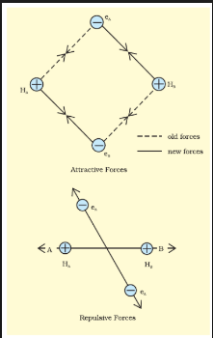

Slide 5
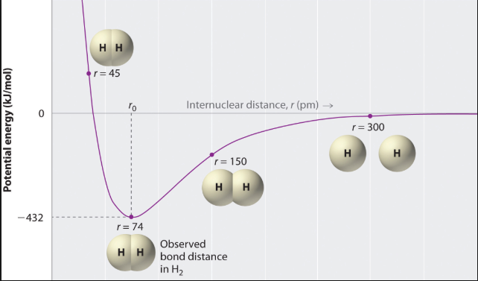

Slide 6
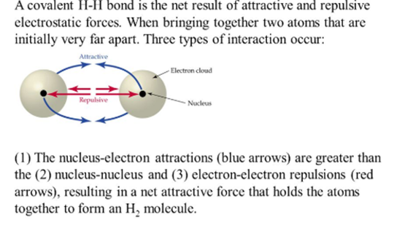

Slide 7
HYDROGEN MOLECULE FORMATION

Slide 8
DIRECTIVE PROPERTY OF COVALENT BOND
The meaning of covalent bonds being directional is that atoms bonded covalently prefer specific orientations in space relative to one another. As a result, molecules in which atoms are bonded covalently have definite shapes. ... Hence covalent bonds show directionality because of the shape of their electron wave function.

Slide 9
Valence bond theory explains about the shape, the formation and the directional properties of bond in polyatomic molecules like methane, ammonia and water in terms of overlapping and hybridisation of atomic orbital

Slide 10
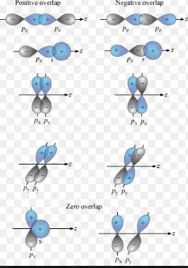
TYPES OF OVERLAPPING

Slide 11
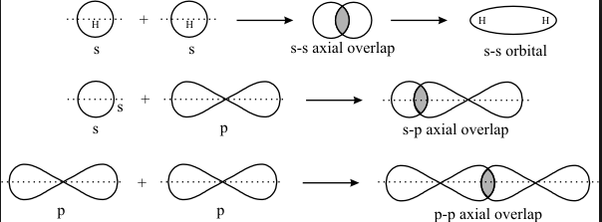
OVERLAPPING OF ATOMIC ORBITALS
SIGMA BOND FORMATION BY AXIAL OVERLAPPING

Slide 12
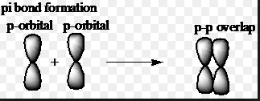
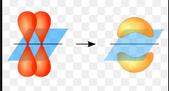
The orbital formed due to sidewise overlapping

Slide 13
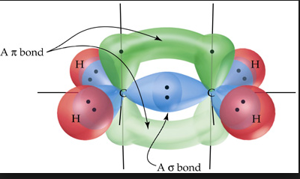
SIGMA AND PI BOND FORMATION IN ETHENE

Slide 15
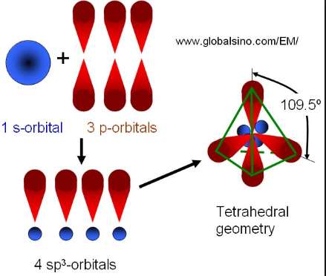
sp³ HYBRIDISATION

Slide 16
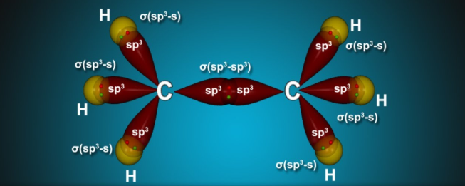
ETHANE

Slide 17
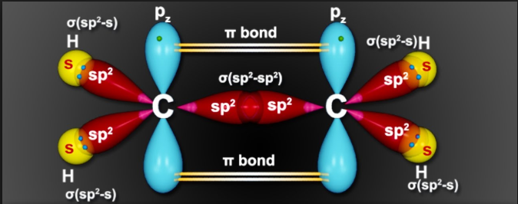
sp² HYBRIDISATION

Slide 18
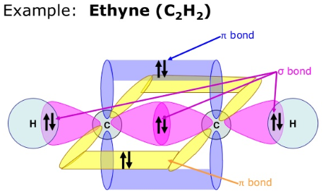
Sp HYBRIDISATION

Slide 19
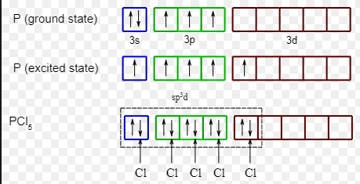
sp³d HYBRIDISATION
PCl₅ MOLECULE

Slide 20
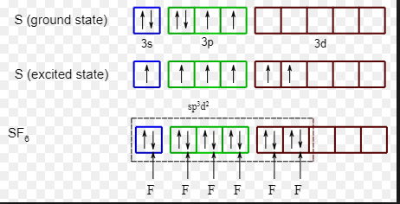
sp³d ²HYBRIDISATION
SF₆ MOLECULE

Slide 21
The Limitations of Valence Bond Theory are:
It fails to explain the tetravalency of carbon.
This theory does not discuss the energies of electrons.
The assumptions about the electrons being localized to specific locations.

